Slide 1
From Excel to Excellent
Variables, Functions and Subroutines, and Classes

Slide 2
GRADING
20% Midterm Project
20% Final Project (Oct 18,2023)
20% Assignment
20% Midterm Examination
20% Final Examination (Oct 25,2023 9.00-11.00)

Slide 3
Variables

Slide 4
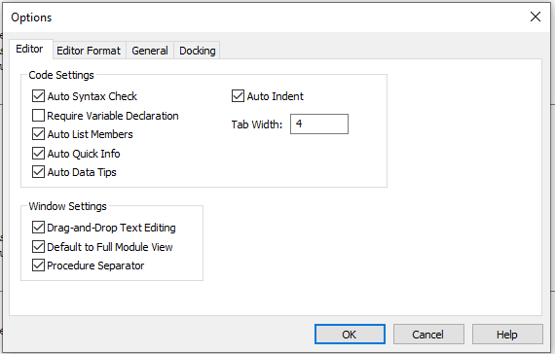
Variable Declaration
Goto Tools > Options in VBE

Slide 5
Variables
Example 1: Show output of the following module
        Sub TestVarType()
        MyVariable1 = "Francis"
        MsgBox "First: " & MyVariable1
        MsgBox VarType(MyVariable1)
        MyVariable1 = 1234
        MsgBox "Second: " & MyVariable1
        MsgBox VarType(MyVariable1)
        End Sub

Slide 6
Variables
Example 1: Solution
The message box will display the following messages in order:
    First: Francis
    8 means it is a string
    Second: 1234
    2 means it is an integer
We call MyVariable1 a variable.

Slide 7
Variables and Data Types
Variables: location names in computer main memory
Data types: types of values that can be assigned to a variable.
The Variant Data Type can hold any type of data: numbers , text or object variables.
    MyVariable1 is an example

Slide 8
Declaring A VBA Variant Data Type Three Ways
There are three ways that you can declare a VBA Variant data type:
By not declaring a variable (without using Option Explicit)
By declaring a variable without a type
By explicitly declaring a variable as a Variant data type

Slide 9
The Basic Rules
A variable will be given by default the VBA Variant Data type if no data type is specified.
If you declare a variable but don't specify a type, then the variable is going to default to a variant data type.
If you declare the variable as a variant it will be a variant.

Slide 10
Implicit Declaration of Variables
We can use a variable without openly(explicitly) declare it if we assign an initial value to it. For example,
    MyFirstName=”John”
Excel VBA will automatically create a varaible MyFirstName as a variant, and it will hold the data as John.

Slide 11
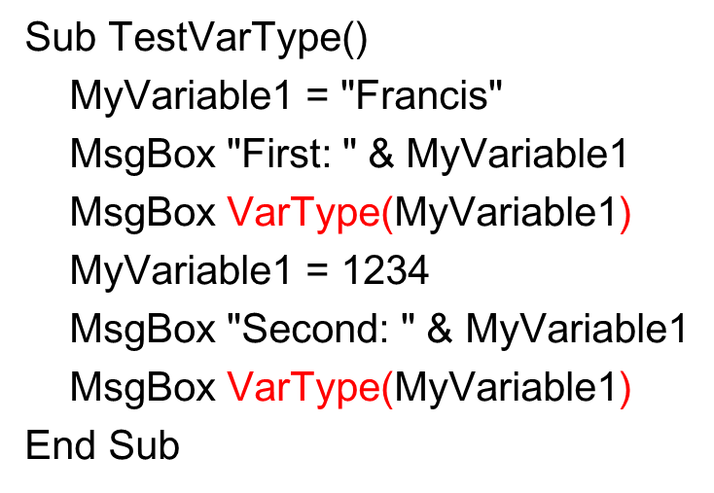
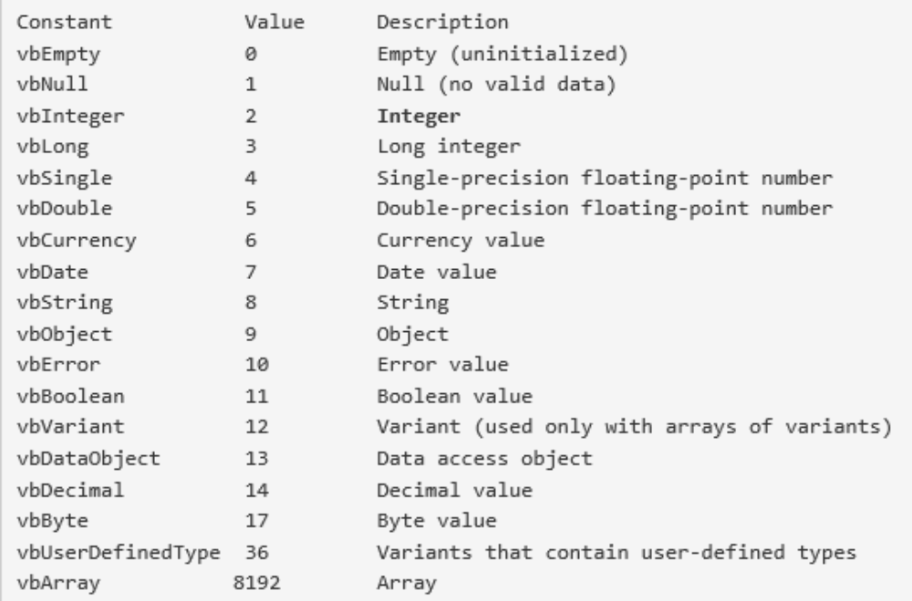
Values returned by VarType()

Slide 12
Variables
Example 2: Show output of the following module
        Sub VarExample()
        Dim X As Integer
        X = 100
        MsgBox "The value of X is " & X
        End Sub

Slide 13
Variables and Data Types
Example 2: Solution
It displays The value of X is 100.
The module explicitly declare a variable X by using the Dim statement.
    Dim variable As DataType

Slide 14
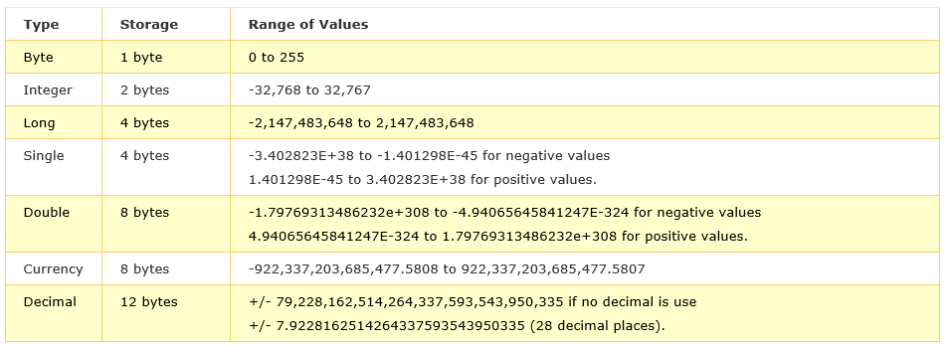
Numeric Data Types

Slide 15
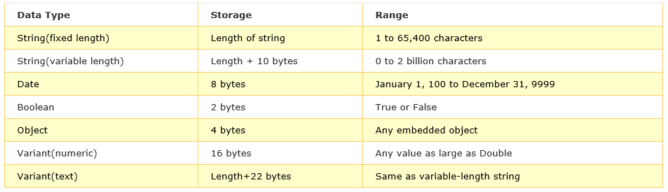
Nonnumeric Data Types

Slide 16
Explicit Declaration of Variables
It is declared using the Dim statement as follows:
    Dim VariableName As DataType
    Dim VariableName1 As DataType1, VariableName2 As DataType2, VariableName3 As DataType3

Slide 17
Example of Explicit Declaration
Dim password As String
Dim yourName As String
Dim firstnum As Integer
Dim secondnum As Integer
Dim total As Integer
Dim doDate As Date
Dim password As String, yourName As String, firstnum As Integer

Slide 18
Declaring Fixed-Length Strings
Dim VariableName as String * n,
where n defines the number of characters the string can hold.
  Dim yourName as String * 10
  yourName can holds no more than 10 Characters.

Slide 19
Declaring Constants
Constants are different from variables in the sense that their values do not change during the running of the program.
  Const Constant Name As Data Type = Value
  Const Pi As Single=3.142
  Const Temp As Double=37
  Const Score As Single=100

Slide 20
Range Data Type
Example 3: Show output of the following module
Sub RangeVariable()
Dim rng As range
Set rng = ThisWorkbook.Worksheets("Sheet1").range("C10")
rng.value = InputBox("Enter Sales for January")
rng.offset(-1, 0).value = "January Sales"
End Sub

Slide 21
Range Data Type
Example 3: Solution
Cell C9 contains January Sales
Cell C10 contains a value from InputBox

Slide 22
Range Data Type
A variable of type Range inherits all the properties and methods of the Range object
The Set declaration statement must be used to initialize the value of a variable of type Range
  For example, to set the variable MyRange equal to cell A1 we would type the following
    Dim MyRange As Range
    .
    Set MyRange = Range(“A1”)

Slide 23
Workbook/Worksheet Data Types
Example 4: Show output of the following module
Sub kl()
Dim wb As Workbook
Dim ws As Worksheet
Set wb = ActiveWorkbook
Set ws = Sheets("Sheet1")
wb.Activate
ws.Select
End Sub

Slide 24
Workbook/Worksheet Data Types
The Workbook data type defines a Workbook object
The Worksheet data type defines a Worksheet object

Slide 25
Object Data Type
Example 5: Show output of the following module
Sub obj()
Dim myObject As Object
Set myObject = range("A1:A15")
myObject.Font.Bold = True
Dim myRange As Excel.range
Set myRange = range("A1:A15")
myRange.Font.Bold = True
End Sub

Slide 26
TypeName()
Example 6: Show output of the following module
Sub TestTypeName()
Dim myObject As Object
Set myObject = Range("A1:A15")
MsgBox TypeName(myObject)
End Sub

Slide 27
Variable Scope
Example 7: Show output of the Example1() and Example2() modules
Sub Example1()
Dim X As Integer
' Local variable, not the same as X in Example2.
X = 100
MsgBox "The value of X is " & X
End Sub
Sub Example2()
Dim X As String
' Local variable, not the same as X in Example1.
X = "Yes"
MsgBox "The answer is " &X
End Sub

Slide 28
Variable Scope
Example 8: Show output after running each module
Dim A As Integer ' Module-level variable.
Private B As Integer ' Module-level variable.
Sub Example1()
A = 100
B = A + 1
End Sub
Sub Example2()
MsgBox "The value of A is " & A
MsgBox "The value of B is " & B
End Sub
Sub Example3()
Dim C As Integer ' Local variable.
C = A + B
MsgBox "The value of C is " & C
End Sub
Sub Example4()
MsgBox A
' The message box displays the value of A.
MsgBox B
' The message box displays the value of B.
MsgBox C
' The message box displays nothing because C was a local variable.
End Sub

Slide 29
Procedure Level vs. Module Level
Procedure level Private declaration
  Sub Sub1()
  Dim i As Integer
  .....
  End Sub
  ----------------------------------
  Sub Sub2()
  Dim i As Integer
  ....
  End Sub
Module level Private declaration
  Dim (or Private) i As Integer
  -------------------------
  Sub Sub1()
  .......
  End Sub
  ------------------------
  Sub Sub2()
  ........
  End Sub

Slide 30
Functions and Subroutines

Slide 31
Subroutines
Example 9: Show output of the Exercise() module
Sub CreateCustomer()
Dim strFullName As String
strFullName = "Paul Bertrand Yamaguchi“
MsgBox strFullName
End Sub
Sub Exercise()
CreateCustomer
End Sub

Slide 32
Subroutines
Procedures with a list of instructions that carry out a task
Why Use Subroutines ?
Organization of code into separate blocks allows for reuse in other modules

Slide 33
Functions
Example 10: Show output of the Exercise1() and Exercise2() modules
  Function CallMe() As String
  Dim Salute As String
  Salute = "You can call me Al"
  CallMe = Salute
  End Function
  Sub Exercise1()
  Msgbox CallMe
  End Sub
  Function CallMe$()
  Dim Salute As String
  Salute = "You can call me Al"
  CallMe = Salute
  End Function
  Sub Exercise2()
  Msgbox CallMe
  End Sub

Slide 34
Functions
Subroutines that return a value
The main difference between a sub and a function is that, after carrying its assignment, a function gives back a result.
  We also say that a function "returns a value".

Slide 35
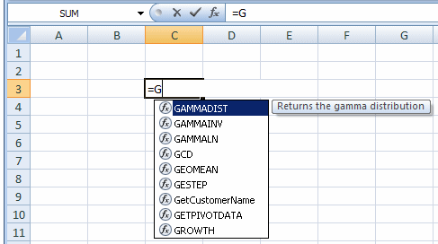
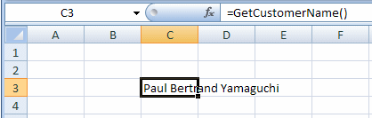
Calling a Function in a Spreadsheet
Function GetCustomerName() As String
GetCustomerName = "Paul Bertrand Yamaguchi"
End Function

Slide 36
Type Character
Example 11: Show output of the ExerciseT() module
Function GetFullName$()
Dim FirstName As String, LastName As String
FirstName = "Patricia"
LastName = "Katts"
GetFullName = LastName & ", " & FirstName
End Function
Sub ExerciseT()
Dim FullName$
FullName = GetFullName()
ActiveCell.FormulaR1C1 = FullName
End Sub

Slide 37
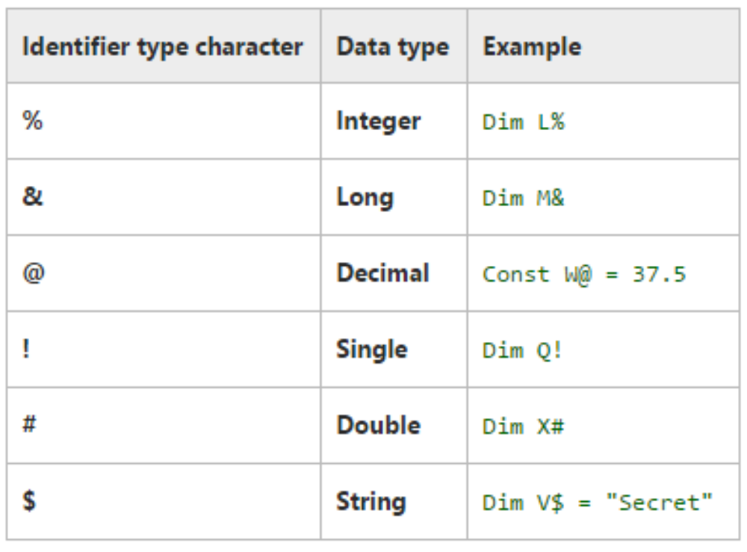
Type Character

Slide 38
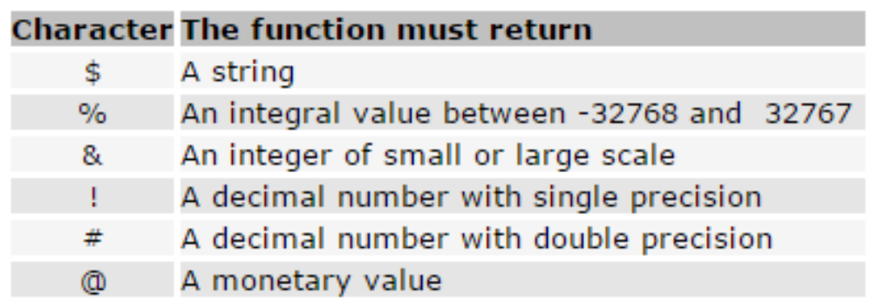
Creating a Function Using a Type Character
Function CallMe() As String
Dim Salute As String
Salute = "You can call me Al"
CallMe = Salute
End Function
Function CallMe$()
Dim Salute As String
Salute = "You can call me Al"
CallMe = Salute
End Function

Slide 39
Subroutine with Arguments
Example 12: Show output of the X() and Y() modules
Sub z(a)
MsgBox a
End Sub
Sub x()
z ("ABC")
End Sub
Sub y()
z "ABC"
End Sub
A value that is supplied to a sub is called an argument.

Slide 40
Function with Arguments
Example 13: Show output of the ShowSum() module
Function sumNo(x, y)
sumNo = x + y
End Function
Sub ShowSum()
varSum = sumNo(3, 5)
MsgBox varSum
End Sub
A value that is supplied to a function is called an argument.

Slide 41
Creating a Function With Arguments
Option Explicit
Public Function CalculatePerimeter(Length As Double, Width As Double) As Double
Dim Perimeter As Double
Perimeter = (Length + Width) * 2
CalculatePerimeter = Perimeter
End Function
Public Function CalculateArea(Length As Double, Width As Double) As Double
Dim Area As Double
Area = Length * Width
CalculateArea = Area
End Function
Write a subroutine to show perimeter and area of a rectangle with width 5 and length 10.

Slide 42
Calling a Function With Argument
Show output of the ExerciseFname().
Private Function GetFullName$(First As String, Last As String)
Dim FName As String
FName = First & Last
GetFullName = FName
End Function
Sub ExerciseFname()
Dim FirstName As String, LastName As String
Dim FullName As String
FirstName = "Patricia "
LastName = "Katts"
FullName = GetFullName(FirstName, LastName)
ActiveCell.FormulaR1C1 = FullName
End Sub

Slide 43
Calling a Function With Argument
Show output of the ExercisePP41().
Private Function GetFullName$(First As String, Last As String)
Dim FName As String
FName = First & Last
GetFullName = FName
End Function
Sub ExercisePP41()
Dim FullName$
FullName$ = GetFullName(Last:="Roberts", First:="Alan ")
ActiveCell.FormulaR1C1 = FullName
End Sub

Slide 44
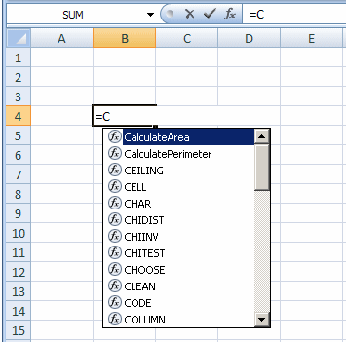
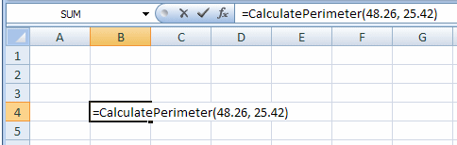
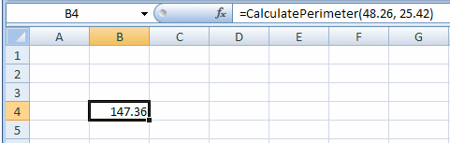
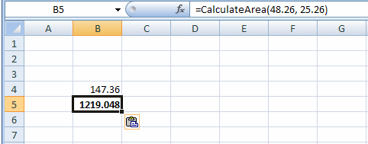
Calling a Sub/Function With Arguments in a Spreadsheet

Slide 45
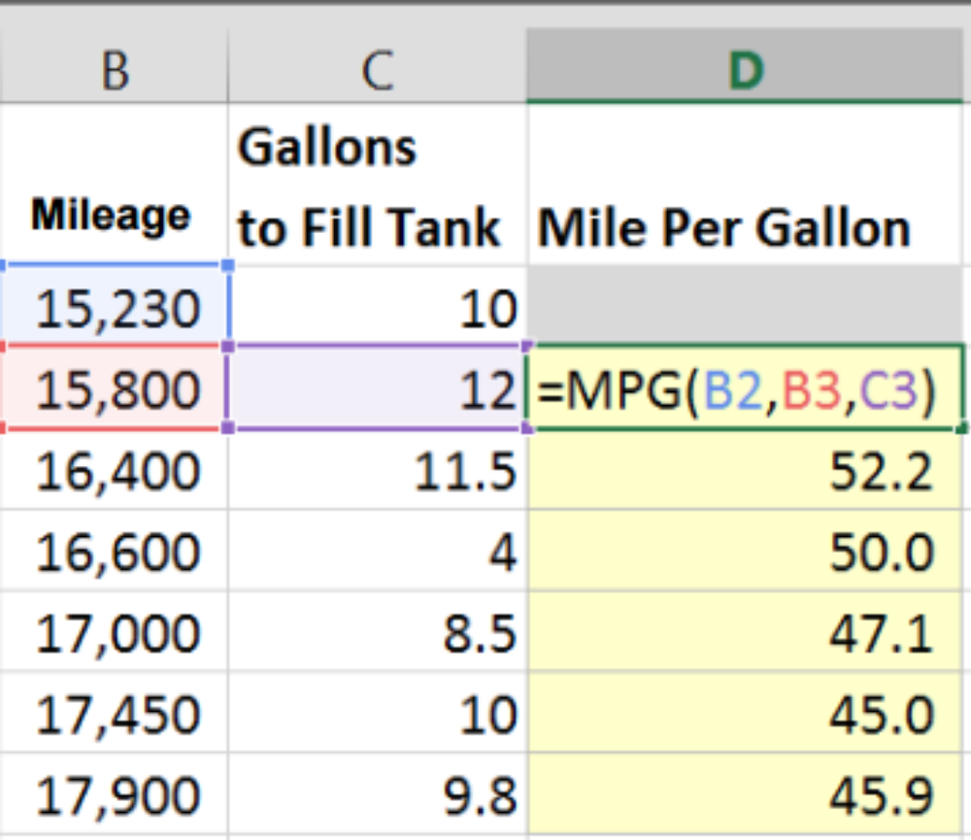
Exercise 1
Write a function MPG to find Miles Per Gallon (End Miles – Begin Miles) / Gallons and use it to find MPG as shown in the worksheet

Slide 46
Passing Arguments
Example 14: Show output of the TestPassing1() and TestPassing2().
Sub AddNo1(ByRef x As Integer)
x = x + 10
End Sub
Sub AddNo2(x As Integer)
x = x + 10
End Sub
Sub TestPassing1()
Dim y As Integer
y = 50
AddNo1 y
MsgBox y
AddNo2 y
MsgBox y
End Sub
Private Sub AddNo3(ByVal x As Integer)
x = x + 10
End Sub
Public Sub TestPassing2()
Dim y As Integer
y = 50
AddNo3 y
MsgBox y
End Sub

Slide 47
Passing Arguments
Example 14: Solution
TestPassing1():
Msgbox with 60
Msgbox with 70
TestPassing2():
Msgbox with 50 why?

Slide 48
Passing Arguments
There are two methods to pass arguments in subs and functions
By reference (default)
By value

Slide 49
Passing Arguments
Passing a value by reference implies that the sub (or function) can access and possibly modify the original value assigned to the variable

Slide 50
Passing Arguments
Passing by value provides a copy of the value of the variable for the procedure or function to use
Therefore, the original value of the variable remains intact

Slide 51
Example 15
Private Function GetFullName$(ByVal First As String, ByVal Last As String)
Dim FName As String
FName = First & Last
GetFullName$ = FName
End Function
Sub ExercisePP49()
Dim FirstName As String, LastName As String
Dim FullName As String
FirstName = "Raymond "
LastName = "Kouma"
FullName = GetFullName(FirstName, LastName)
ActiveCell.FormulaR1C1 = FullName
End Sub
Show output of the ExercisePP49()

Slide 52
Exercise 2
Write a subroutine to show perimeter and area of a rectangle with width 5 and length 10.
Public Function CalculatePerimeter(ByVal Length As Double, _
ByVal Width As Double) As Double
Dim Perimeter As Double
Perimeter = (Length + Width) * 2
CalculatePerimeter = Perimeter
End Function
Public Function CalculateArea(ByVal Length As Double, _
ByVal Width As Double) As Double
Dim Area As Double
Area = Length * Width
CalculateArea = Area
End Function

Slide 53
Example 16
Show output of the ExercisePP51()
Private Sub ShowResult(ByVal Result As Double)
Result = 145.85
End Sub
Public Sub ExercisePP51()
Dim Number As Double
ShowResult Number
ActiveCell.FormulaR1C1 = Number
End Sub

Slide 54
Example 17
Show output of the ExercisePP52()
Private Sub ShowResult(ByRef Result As Double)
Result = 145.85
End Sub
Public Sub ExercisePP52()
Dim Number As Double
ShowResult Number
ActiveCell.FormulaR1C1 = Number
End Sub

Slide 55
Example 18
Show output of the ExercisePP53()
Private Sub ShowResult(Result As Double)
Result = 145.85
End Sub
Public Sub ExercisePP53()
Dim Number As Double
ShowResult Number
ActiveCell.FormulaR1C1 = Number
End Sub

Slide 56
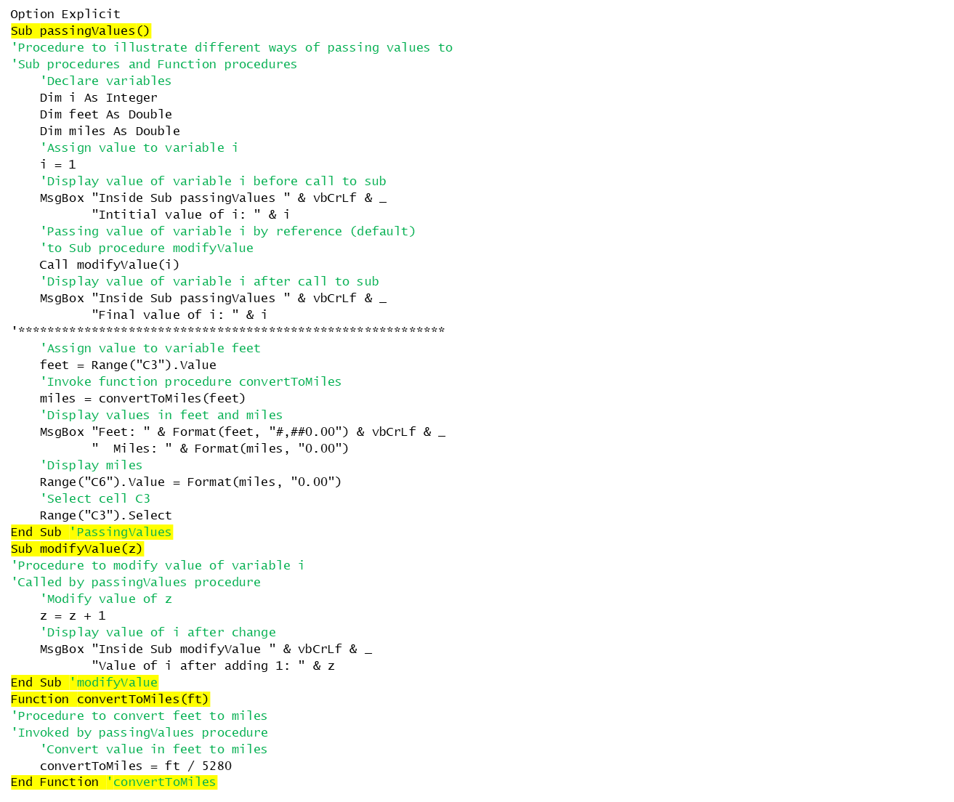
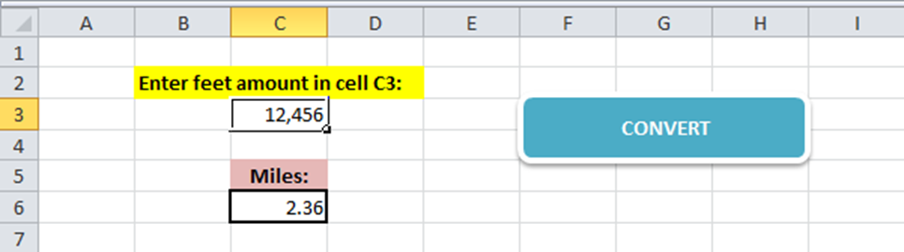
Exercise 3

Slide 57
Scope of a Sub/function
The scope of a sub procedure, like a variable, can also be defined as Public or Private
Consider two private subs: Test1() and Test2(). They are both in Module1. They can call one another.
  Private Sub Test1()
  MsgBox "This is Test1"
  Call Test2
  End Sub
  ----------------------------------
  Private Sub Test2()
  MsgBox "This is Test2"
  End Sub

Slide 58
Scope of a Sub/function
The third sub procedure called Test3() is public but in Module2.
  Sub Test3()
  MsgBox “This is Test3”
  ‘ call test1?
  ‘ call test2?
  End Sub
However, Test3() can be called from one of our private procedures because its scope is Public
  Private Sub Test1()
  MsgBox “This is Test1”
  Call Test3
  End Sub

Slide 59
Scope of a Sub/function
The fourth sub procedure called Test4() is also public and in Module1
Test4() is public, it can still call Test1() and Test2() since they are in the same module
  Sub Test4()
  MsgBox “This is Test4”
  Call Test1
  End Sub

Slide 60
Classes (User Defined Data Types )

Slide 61
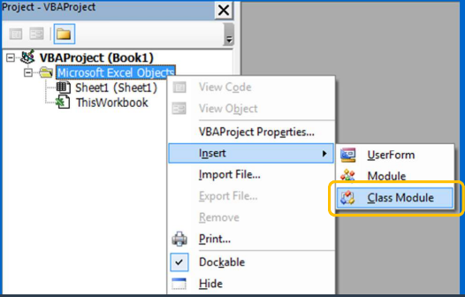
Create a class definition
Insert>Class Module
Or

Slide 62
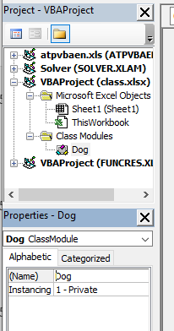
Create a class definition
We will get “Class1” under the folder “Class Modules”
Rename “Class1” to “Dog” by choosing View>Properties Window

Slide 63
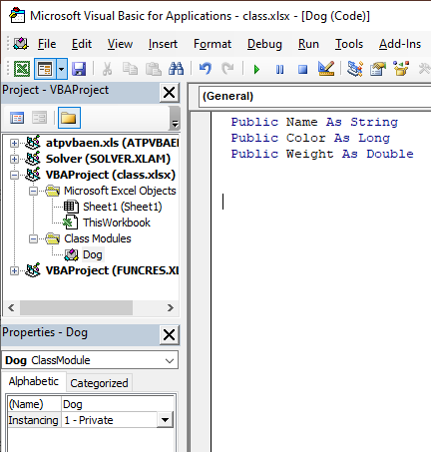
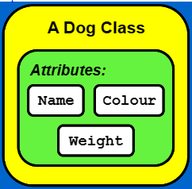
Making the Class Attributes

Slide 64
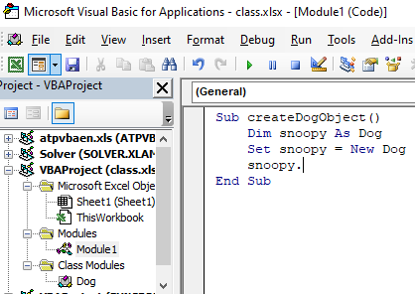
Making a Dog from the Class
Sub createDogObject()
Dim snoopy As Dog
Set snoopy = New Dog
snoopy.Name = "Snoopy"
snoopy.Color = vbWhite
snoopy.Weight = 30
MsgBox "My first dog is called " & snoopy.Name
End Sub

Slide 65
Exercise 4
Extending the createDogObject() subroutine to include the second dog named Odie with color vbYellow and weight 25; and show the following message on the message box.
    My first dog is called Snoopy
    And my second dog is called Odie.

Slide 66
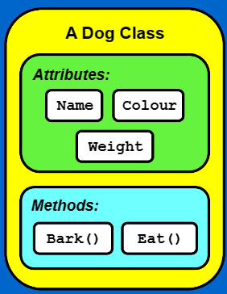
Extending the Dog Class
Public Name As String
Public Color As Long
Public Weight As Double
Sub bark(ByVal Woof As String)
MsgBox Woof, , Name
End Sub
Sub eat()
Weight = Weight + 1
If Weight >= 35 Then
MsgBox "Oh dear, I'm full."
End If
End Sub

Slide 67
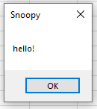
Call bark() Method
Sub createDogObject()
Dim snoopy As Dog
Set snoopy = New Dog
snoopy.Name = "Snoopy"
snoopy.Color = vbWhite
snoopy.Weight = 30
snoopy.bark "hello!"
End Sub

Slide 68
Exercise 5
Using the Eat method we can use a loop to keep on feeding the dogs.
Feed the dog whose name was typed in. Stop feeding the dogs if the user didn’t type anything.
Dim DogToFeed As String
Do
DogToFeed = InputBox("Feed which dog?")
If DogToFeed = "Snoopy" Then
Snoopy.Eat
ElseIf DogToFeed = "Odie" Then
Odie.Eat
End If
Loop Until DogToFeed = "“

